Slide 1

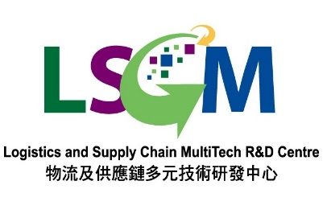








“BIM Square”: Blockchain and i-Core-enabled Multi-stakeholder Building Information Modelling Platform for Construction Supply Chain Management in Hong Kong 基於區塊鏈、建築信息模型及物聯網的面向香港建造業多持份者的物流及供應鏈管理平台研發 Kick-off Meeting Funded by HKSAR ITC ITP/029/20LP (From 01/01/2021-31/12/2022)

Slide 2



Project Summary
Duration: | 24 Months
Start Time: | 01 Jan 2021
Budget (HKD): | HK$10.36m = 7.275m (ITC) + 3.085m (Sponsors)
Project Coordinator: | Prof. Wilson Lu, Faculty of Architecture, REC, HKU
Principal Investigators: | Ir. K.L.Tam, Estate Office, HKU Prof. Anthony G.O.Yeh, Faculty of Architecture, DUPAD, HKU Prof. S.M. Yiu, Faculty of Engineering, CS, HKU Prof. George G.Q. Huang, Faculty of Engineering, ISMSE, HKU Dr. Fan Xue, Faculty of Architecture, REC, HKU
Sponsors & Pilot Organizations: | Paul Y. Engineering Group Ltd Afina Data Systems Ltd iMax Modular Pte Ltd Yahgee Modular House Co.,Ltd AD+RG Architecture Design and Research Group Ltd

Slide 3
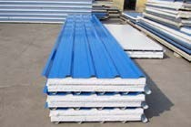

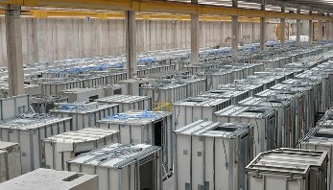

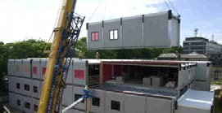





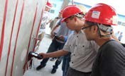
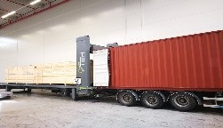
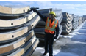

Application Scenarios
Universal, decentralized, multi-stakeholders (e.g., for MiC) in the construction industry in Hong Kong
I
ncluding
Process Management
Progress monitoring
Inventory, location of components
Cross-border logistic control
Motion during assembly
Raw material supplies
Design Production
Storage
Logistics
On-site storage
and assembly
Quality Assurance
Provenance issues
In-factory testing and quality supervision
Truck loading
Quality inspection
Post-construction inspection

Slide 4
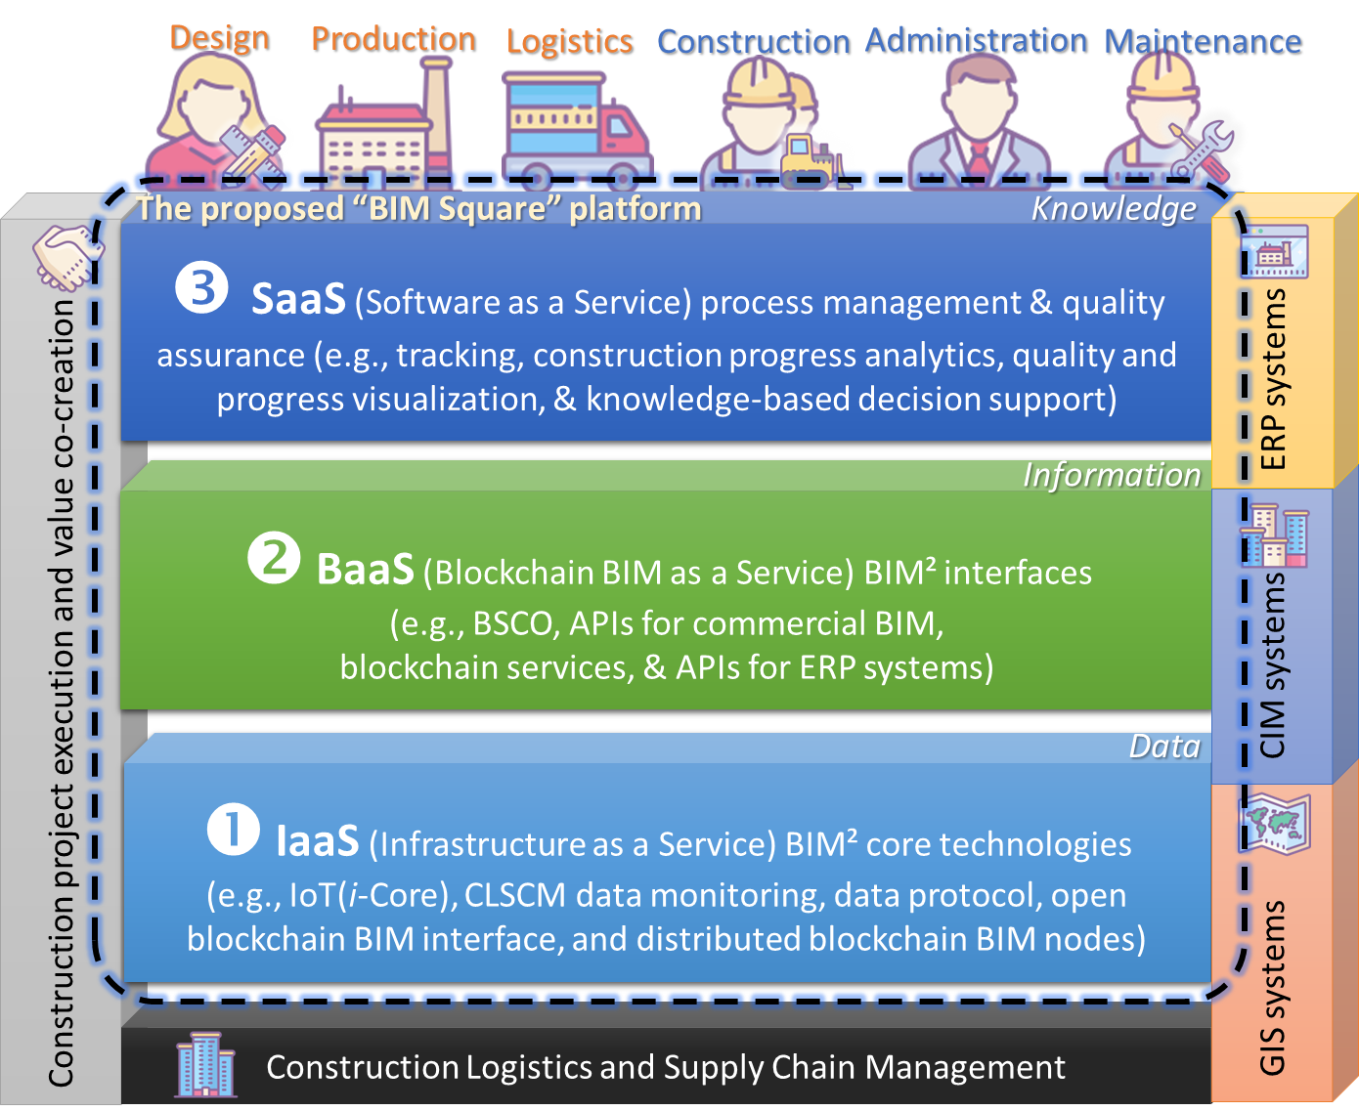
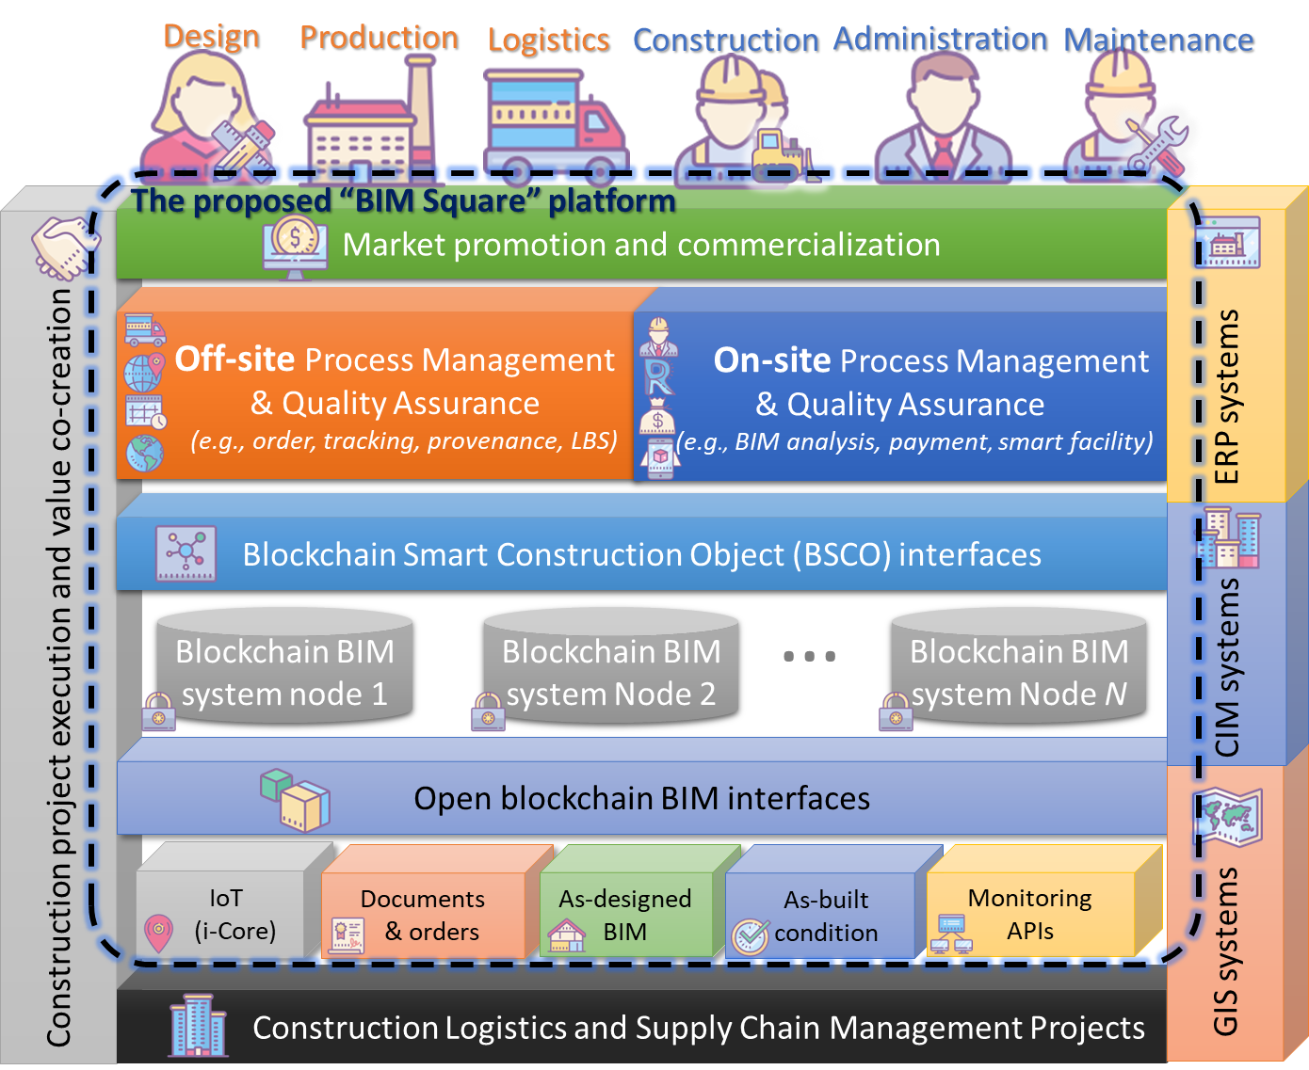
Proposed Solutions

Slide 5
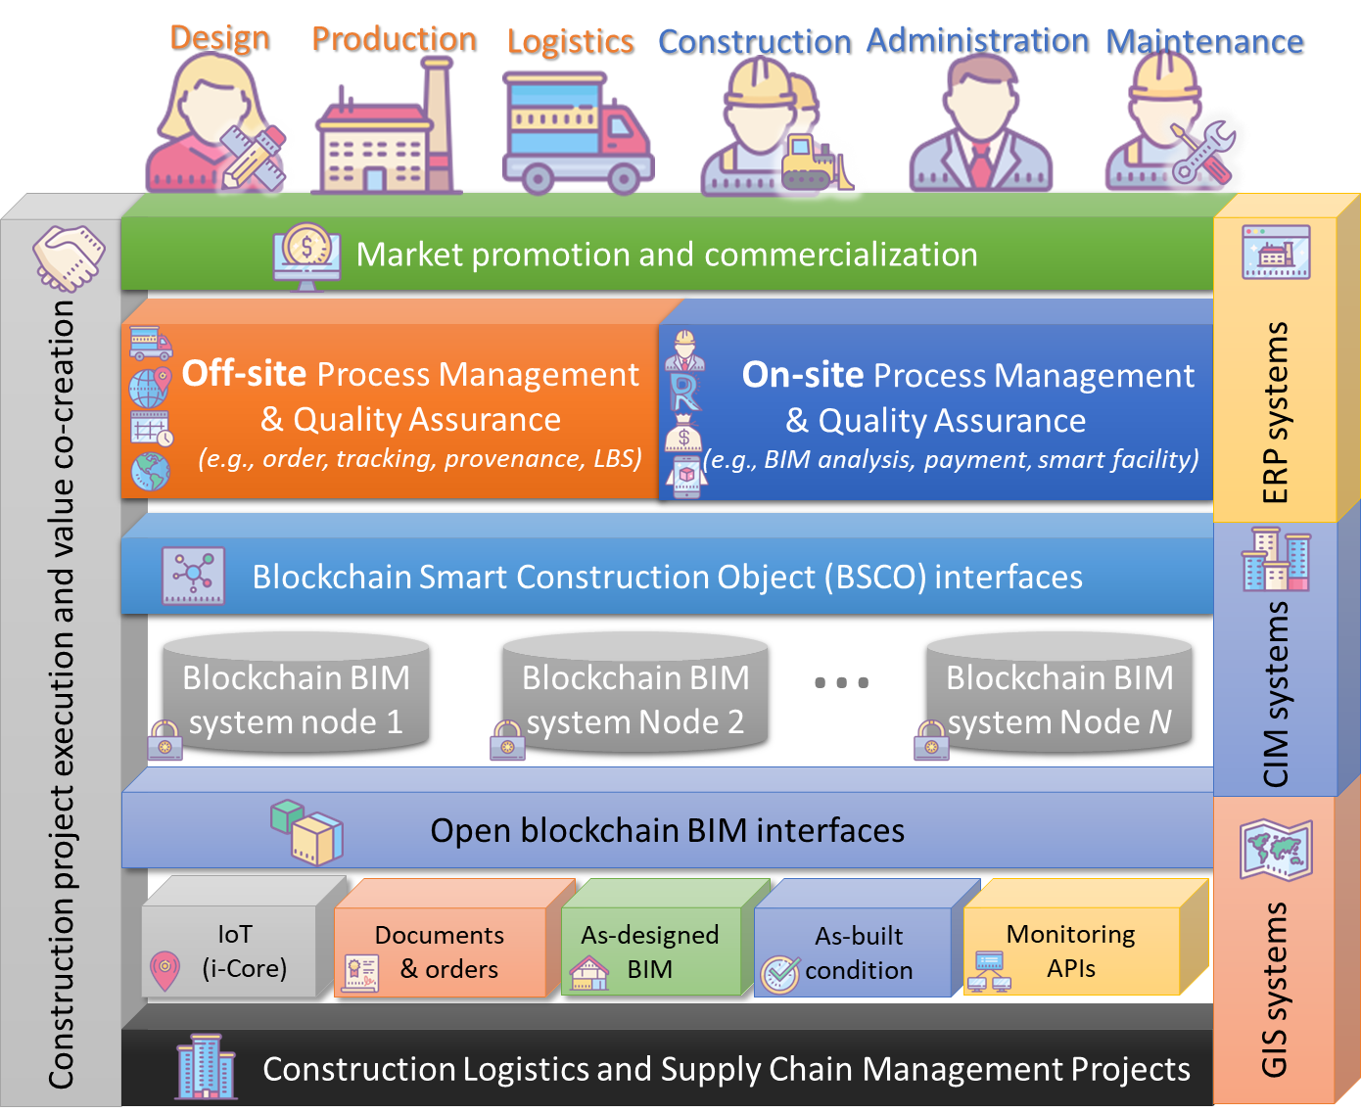
Project Deliverables
5
1. Prof. W.S. Lu:
Core technologies and protocols
2. Prof. S.M. Yiu:
Blockchain runtime and interfaces
3. Prof. G.O.Yeh:
Off-site process management & quality assurance
Dr. Fan Xue:
On-site process management & quality assurance
Prof. G.H. Huang:
Market Promotion and Commercialization
Ir. K.L.Tam:
Project Pilots
3
4
2
1
6

Slide 6
















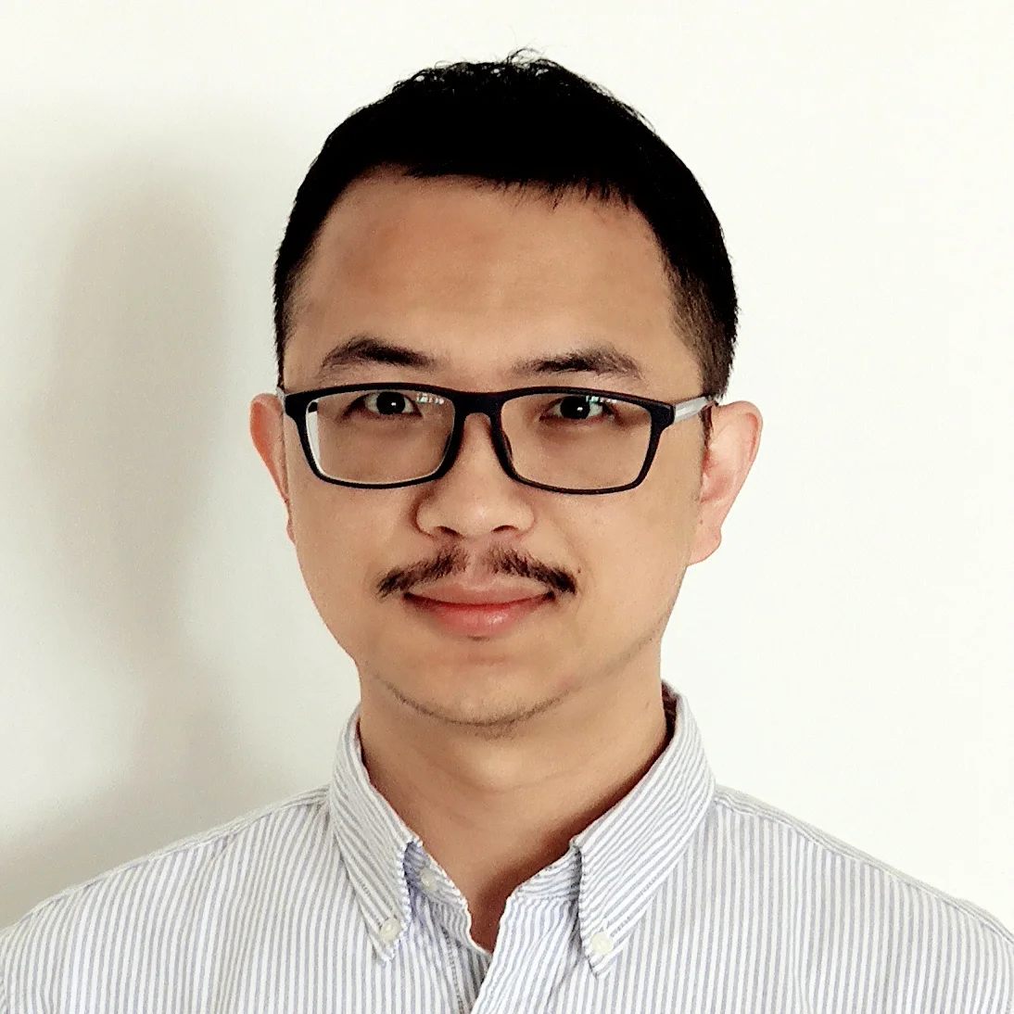
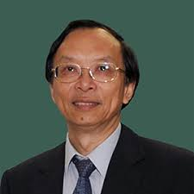







Project Organizational Structure – Strategic & Tactical Level
LSCM
Lead Applicant
Leading
HKABAEIMA
HKU-EO
Paul Y.
Engineering
HKU-FoA
HKCIC
HKU-Feng
HKCA
Steer Committee
Co-PI
Co-PI
PC
Co-PI
Co-PI
Co-PI
ManagementCommittee
Ir. K.L.TAM
Dr. Xue FAN
Prof. W.S.LU
Prof.G.O.YEH
Prof.S.M.YIU
Prof.G.Q.HUANG
PM
PA
Dr. Xiao LI
Dr. Jing Wang
Project Team
Research Leader
Tech Leader
App Leader
Ms. Jinying XU
Mr. Rui Zhao
Mr. Liupengfei WU

Slide 7


Project Organizational Structure – Operation Level
Coordinate
Participate

Slide 8
Milestone
Date | Milestones
1st Project Milestone: (01/01/2021 -30/06/2021) On-going | 1.1 Project Kick-off and Establishment of Website 1.2 Business Process Modeling: Pilots 1, 2 & 3 1.3 System Requirement Analysis: Pilots 1, 2 & 3 1.4 Software Architecture 1.5 IaaS Core Technologies (Alpha Version) | Prof. W.S. LU; Prof. S.M. YIU Prof. G.O.Yeh; Dr. Fan Xue Prof. G.O.Yeh; Dr. Fan Xue Team Prof. W.S. LU
2nd Project Milestone: (01/07/2021 -31/12/2021) On-going | 2.1 IaaS Core Technologies (Beta Version) 2.2 Pilots 1, 2, & 3: Installing i-Cores, Data Collection 2.3 Pilots 1, 2, & 3: BaaS Function Structure and Interfaces (Alpha Version) 2.4 Pilots 1, 2, & 3: Testing of SaaS Process Management and Quality Assurance Applications (Alpha Version) 2.5 Project Annual Report & Annual Steering Meeting to LSCM 2.6 Dissemination of Project Fliers and Booklets 2.7 Demo Systems (Beta Version) | Prof. W.S. LU Prof. W.S. LU Prof. S.M. YIU Prof. G.O.Yeh; Dr. Fan Xue Team Prof. G.H. Huang & Ir.K.L.Tam Team
3rd Project Milestone: (01/01/2022 -30/06/2022) On-going | 3.1 IaaS Core Technologies (RC Version) 3.2 Pilots 1, 2, & 3: Extended Offline Testing of BaaS Function Structure and Interfaces (Beta version) 3.3 Pilots 1, 2, & 3: Extended Offline Testing of SaaS Process Management and Quality Assurance Applications (Beta version) 3.4 Pilots 1, 2, & 3: Tests of APIs 3.5 Dissemination of Project Workshop / Conference 3.6 User manuals & Demo systems (RC version) | Prof. W.S. LU Prof. S.M. YIU Prof. G.O.Yeh; Dr. Fan Xue Prof. G.O.Yeh; Dr. Fan Xue Prof. G.H. Huang & Ir.K.L.Tam Team
4th Project Milestone: (01/07/2022 -31/12/2022) On-going | 4.1 IaaS core technologies (1.0 Version) 4.2 Pilots 1, 2, & 3: Online Testing and Deployment of BaaS Function Structure and Interfaces (1.0 Version) 4.3 Pilots 1, 2, & 3: Online Testing and Deployment of SaaS Process Management and Quality Assurance Applications (1.0 Version) 4.4 Final Reporting Meeting to LCSM 4.5 Update of Project Dissemination Website 4.6 Developers’ Manual 4.7 8 Copies of Demo Systems (1.0 Version) for Six PI/Co-PIs, LSCM, and CIC | Prof. W.S. LU Prof. S.M. YIU Prof. G.O.Yeh; Dr. Fan Xue Team Prof. S.M. YIU Team Team

Slide 9
Milestone 1 – App Schedule

Slide 10
Milestone 1 – App Schedule

Slide 11
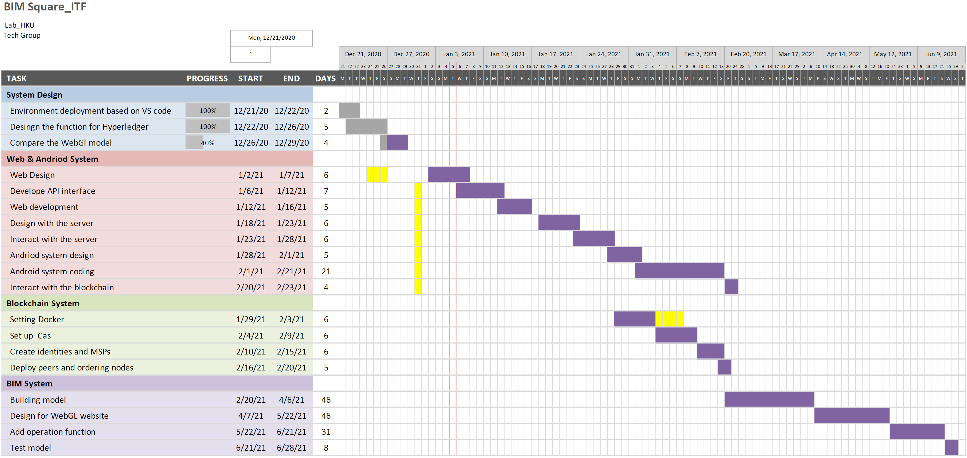
Milestone 1 – Tech Schedule

Slide 12
Milestone 1 – Research Schedule

Slide 13
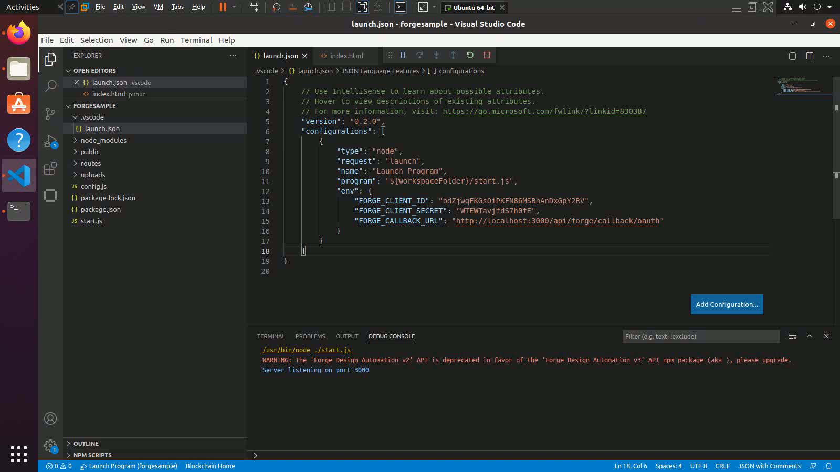
Demo System

Slide 14
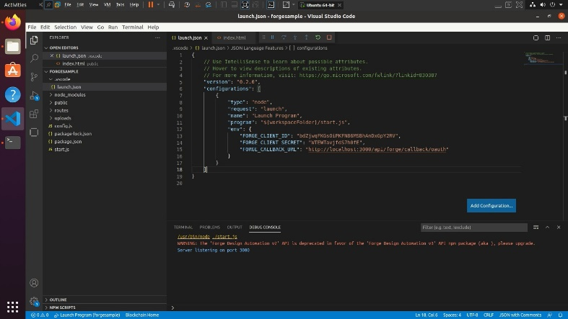
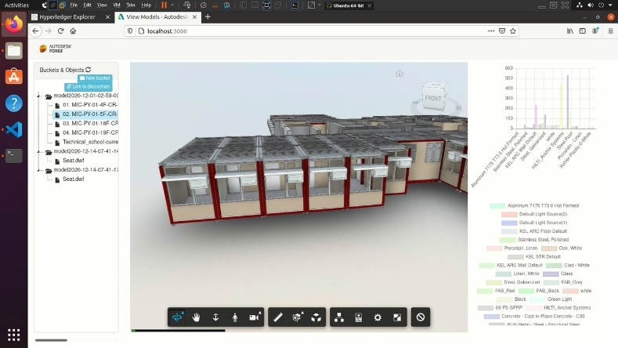
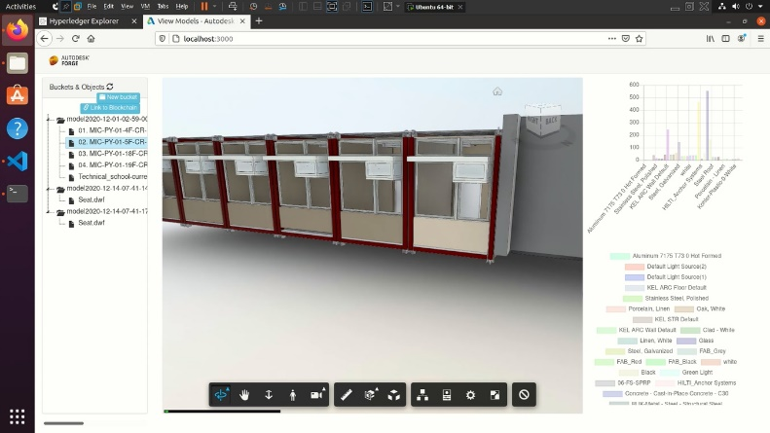
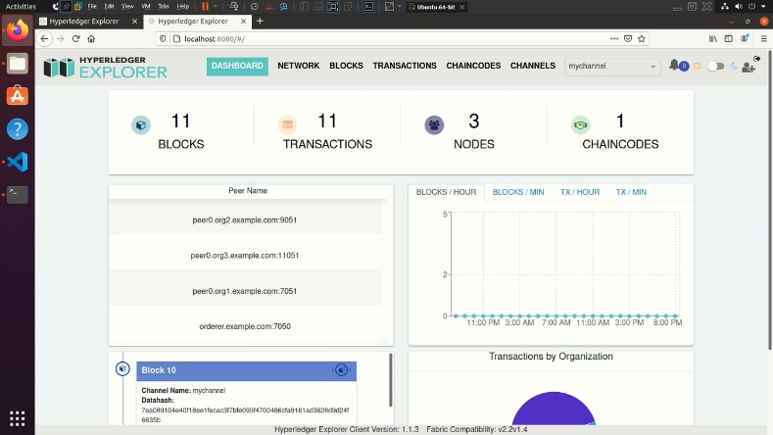
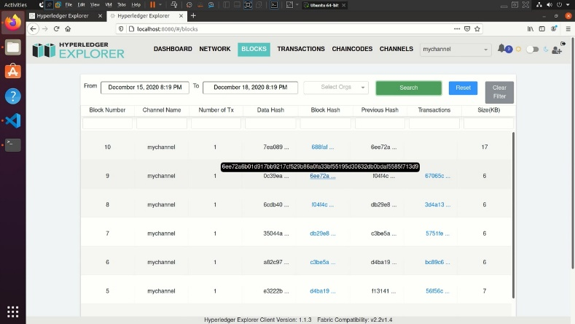
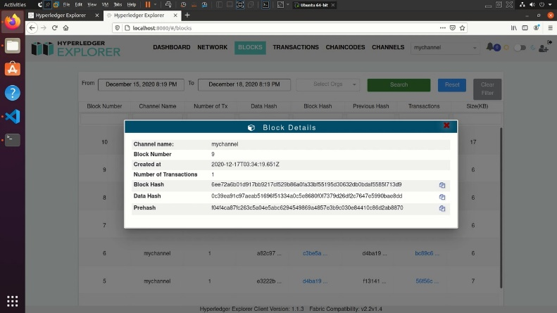
Demo System
Start the code with the VSCode compiler
BIM Model
BIM Model link to blockchain system
The main page of the blockchain system
The historical transaction page of the blockchain system
The deatil transaction page of the blockchain system

Slide 15
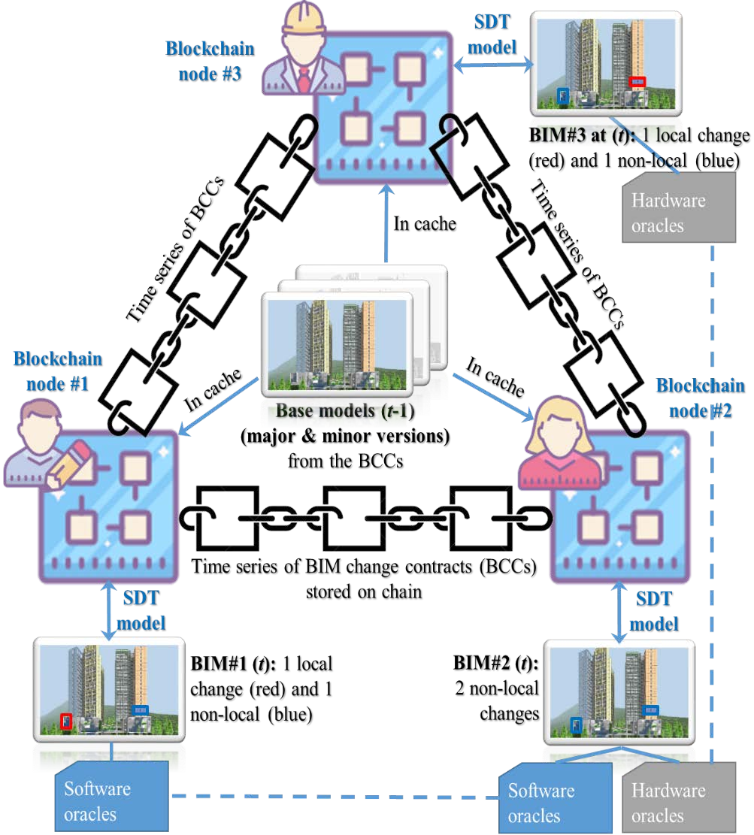
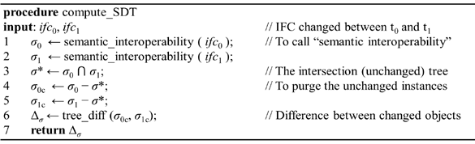
Research Breakthroughs: Blockchain BIM
BIM² links BIM into Blockchain
Semantic differential transactions (SDT) model
In-house developed by us
Minimal information redundancy for blockchaining
BIM change contract (BCC)
Blockchaining a BIM
Like a “bank statement”
of change transactions
as small as 0.02%# BIM size
BIM_{t} = BIM₀+Σ_{t} SDT_{i}
Examples
A few lines in JSON
With BIM semantic hierarchy
A permissioned blockchain

Slide 16
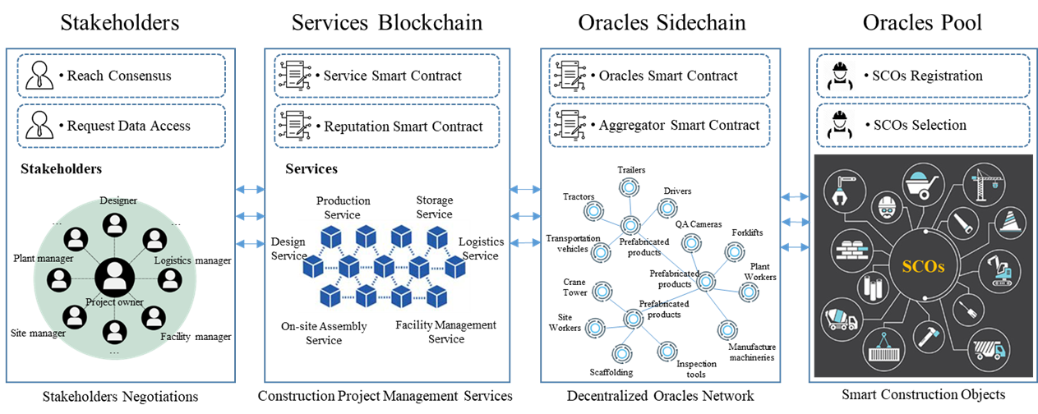
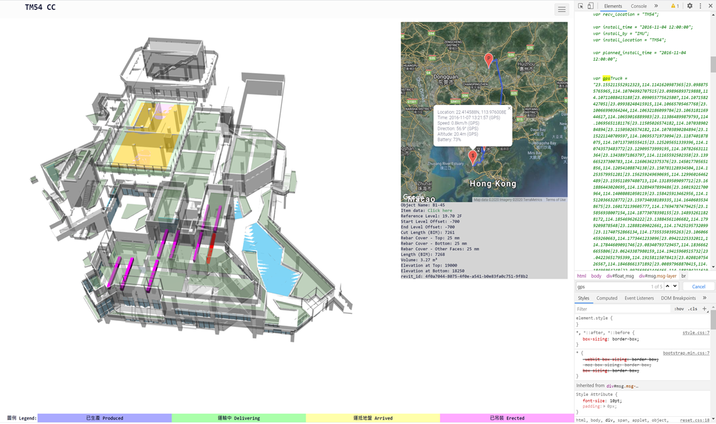
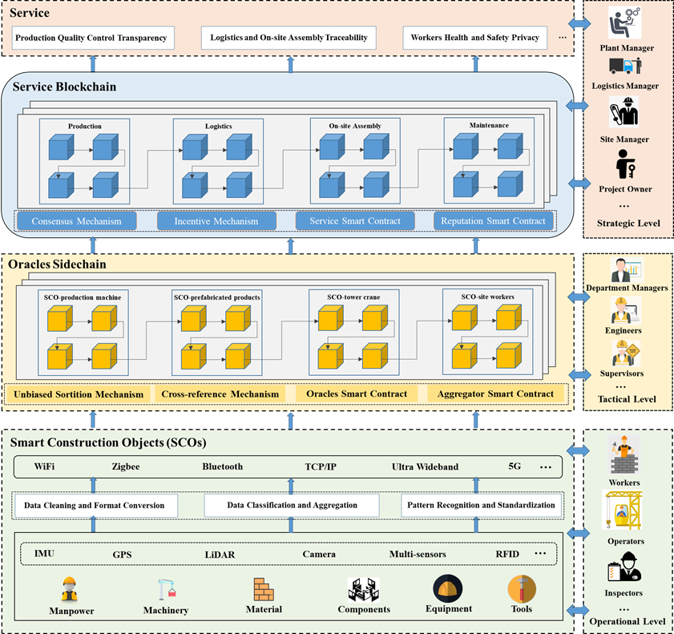
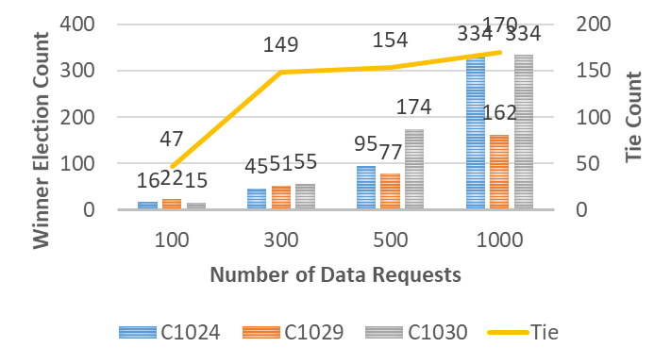
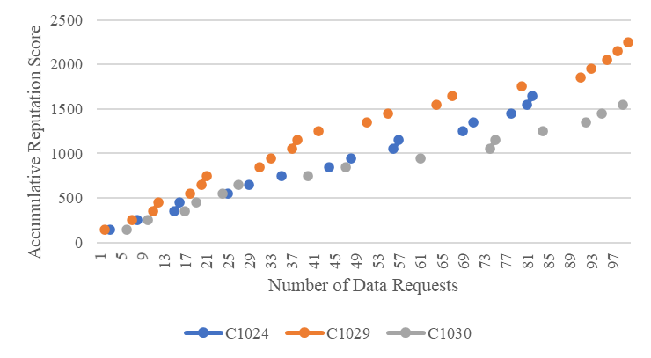
Research Breakthroughs: Blockchain Oracles
Smart Construction Objects enabled Blockchain Oracles
Single Point of Failure (SPoF), Such as One Source of Information
from the Centralized BIM Platform
Trustworthy Data with Good Quality
On-chain, Cross-chain, Off-chain Interactions
Smart Contracts
Service Smart Contract (SSC)
Reputation Smart Contract (RSC)
Aggregator Smart Contract (ASC)
Oracles Smart Contract (OSC)

Slide 17
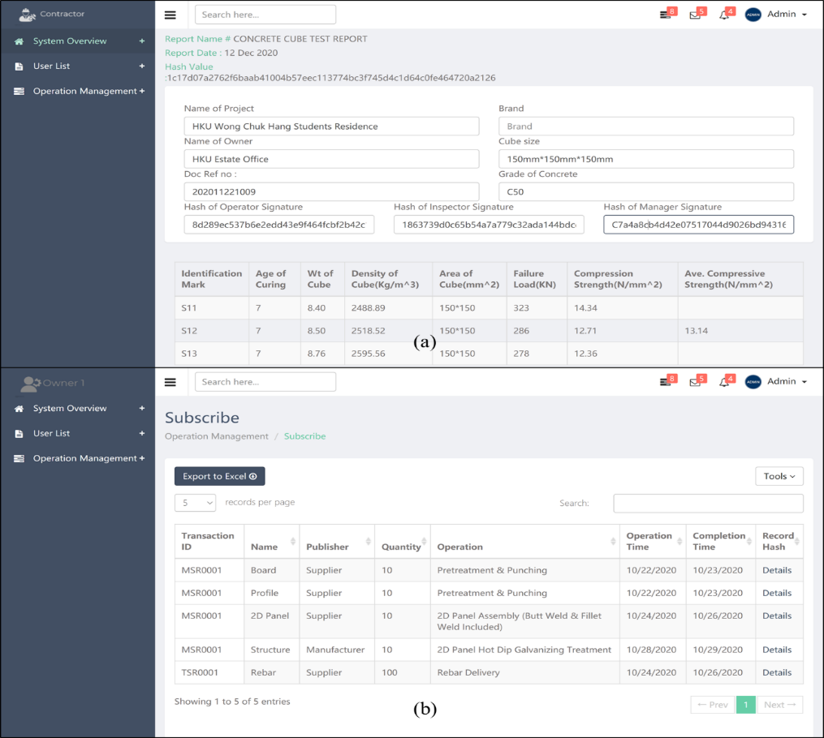
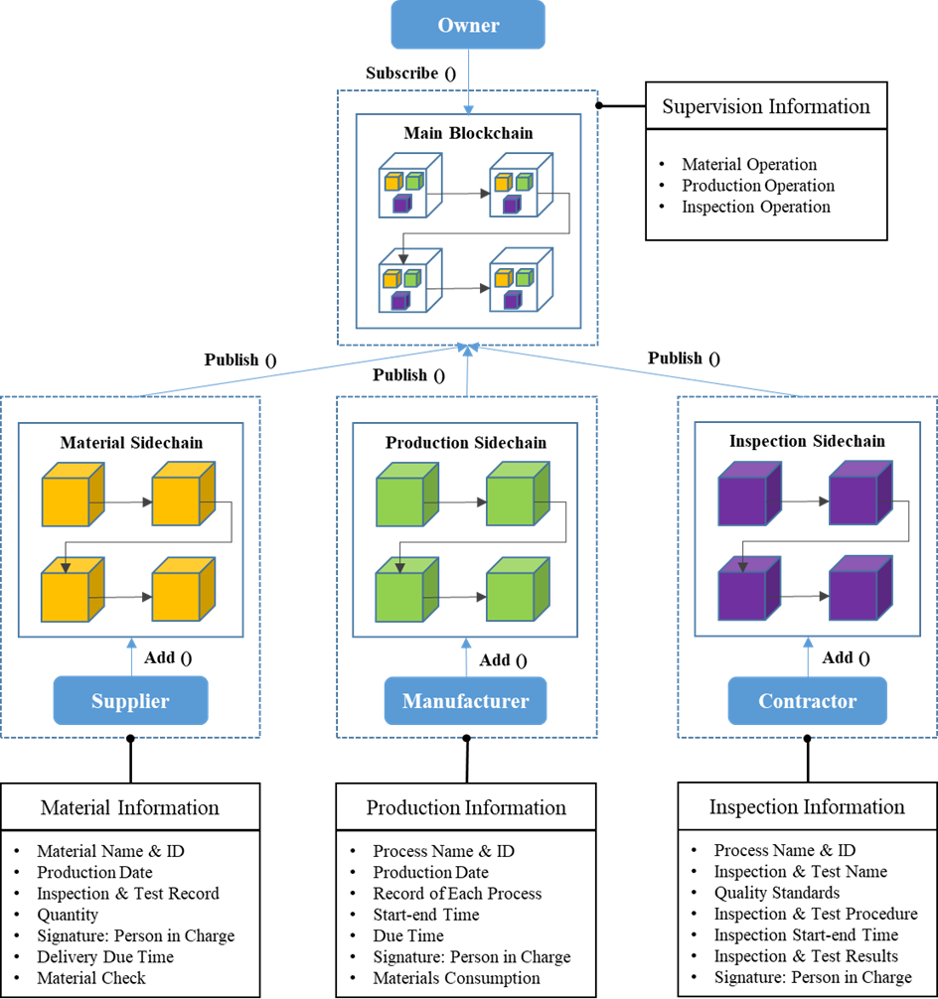
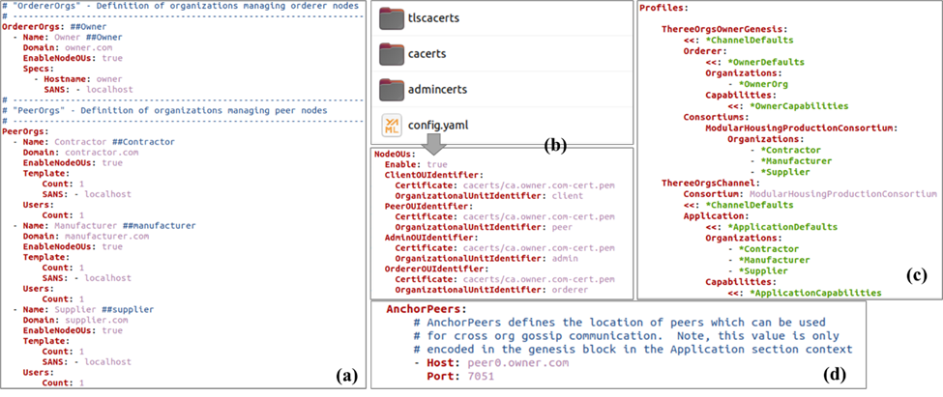
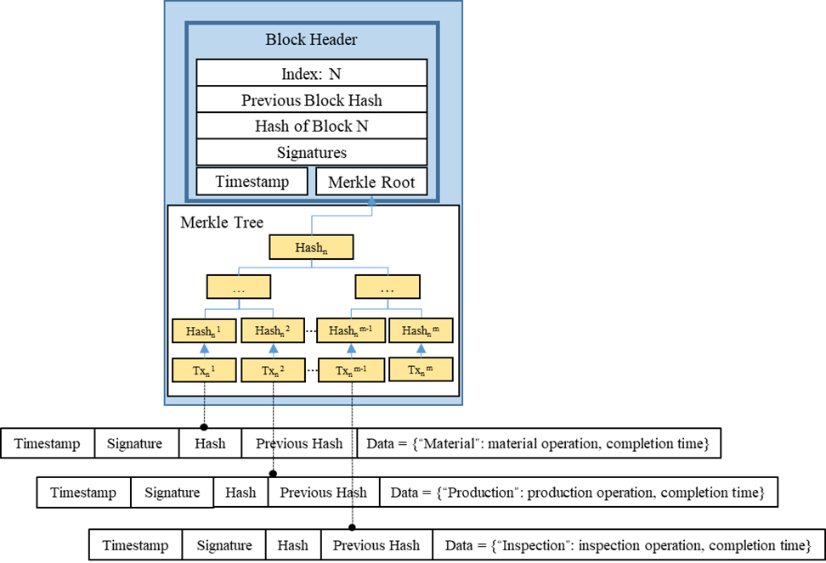
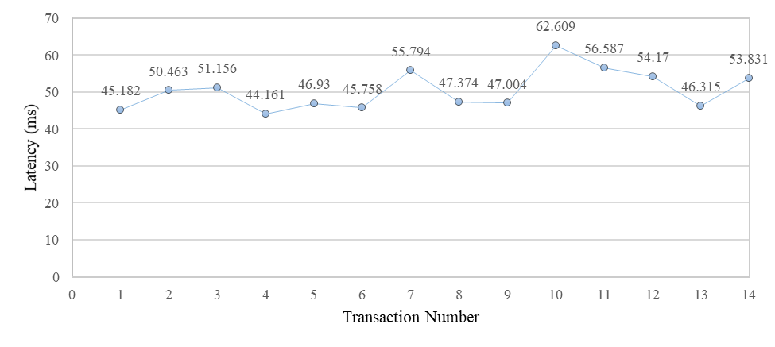
Research Breakthroughs: Two Layer Adaptive Blockchain
Two-layer Adaptive Blockchain-based Supervision Model
Two-Layer Adaptive Blockchain Structure
Supervision Processes (Registration, Publish-subscribe, Sorting Service, Consensus)
Smart Contracts
Performance Analysis of the TABS
Storage Cost (148.86KB vs 121.92MB)
Latency (Millisecond Level vs Few Days)
Privacy (Operation record, transaction data)

Slide 18
BIM SQUARE
a blockchain and i-core-enabled BIM platform
Thank you!

Slide 19
1 Research questions 科學問題
Three major questions
❶ What form of BIM for blockchain in our construction setting?
public, private, or consortium blockchain
Or a new structure specified for multi-role construction projects?
we do not want to duplicate redundant information in the blockchain
❷ How are the BIM information and functions initiated?
To avoid “Garbage in, Garbage out”
by IoT “blockchain oracles” at source
❸ How is the bi-directional blockchain BIM synchronised to prompt smart applications?
between the cyber and physical worlds to support smart CLSCM applications

Slide 20
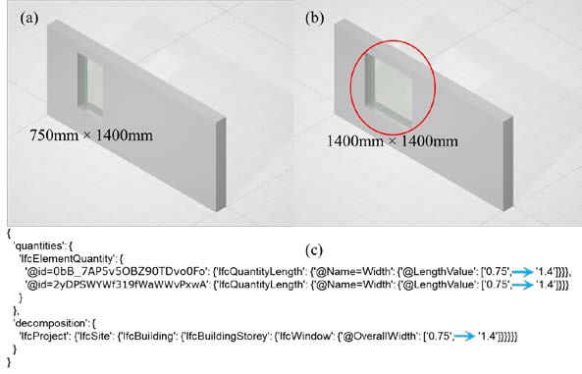
1.1 Key innovation 1 創新點1 – Blockchain BIM (World first*)
BIM² links BIM into Blockchain
Semantic differential transactions (SDT) model
In-house developed by us
Minimal information redundancy for blockchaining
BIM change contract (BCC)
Blockchaining a BIM
Like a “bank statement”
of change transactions
as small as 0.02%# BIM size
BIM_{t} = BIM₀+Σ_{t} SDT_{i}
Examples
A few lines in JSON
With BIM semantic hierarchy
A permissioned blockchain
*: As far as we are concerned as of Apr 2020; #: Results of a 27.4MB BIM designed by Autodesk Revit

Slide 21
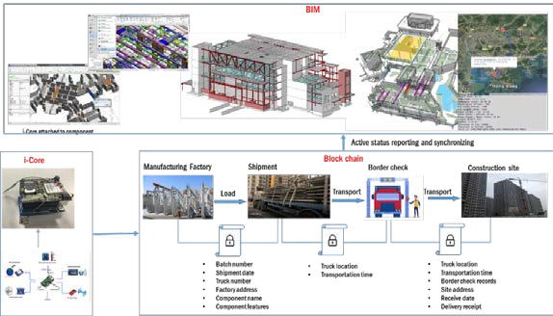
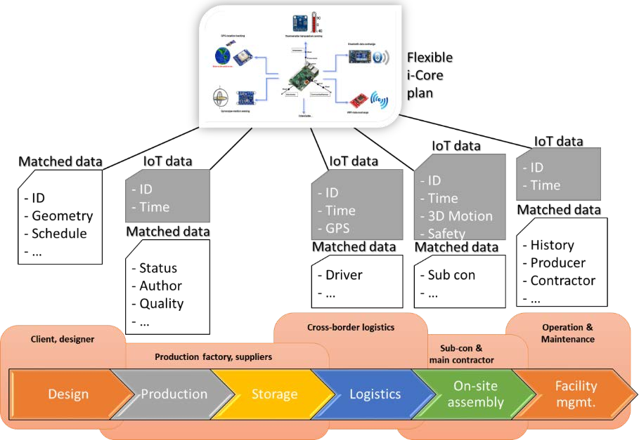
1.2 Key innovation 2 創新點2 – i-Core “oracle”
BIM² has inbound and outbound oracles
Core as “hardware oracles”
100% IP of HKU
Construction edge computing devices
Flexible configurations
Model 1: Low-power LBS manufacturing & logistics
Model 2: Motion tracking on site
High-power, multi-source sensor fusion
Synchronizing real process with blockchain BIM
Monitoring: Physical → cyber
Feedback: Cyber → physical

Slide 22
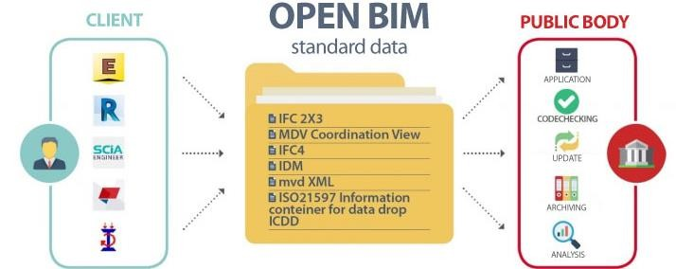
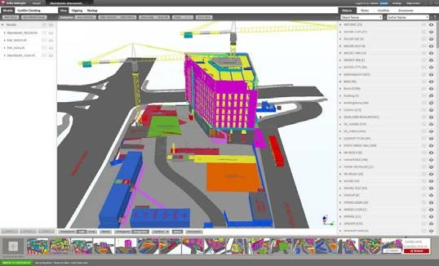
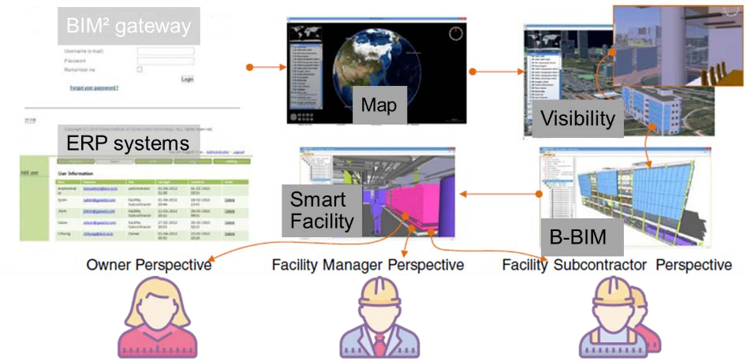
1.3 Key innovation 3 創新點3 – Open BIM
BIM² is an open “square”
Open BIM-based
Compatible with ISO16739-1:2018 standards (IFC)
Promoting open BIM
Good for government/ public body’s administration
Also compatible with commercial BIM software
As an affordable BIM software
Low-cost, flexible SaaS plans
With popular BIM functions for Hong Kong
Affordable by large and small business
New marketing opportunities

Slide 23

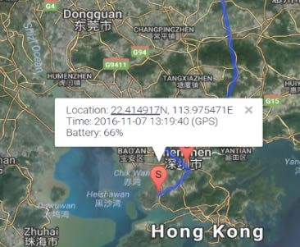

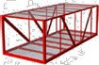
2 Pilot 1 試驗 1 – Off-site LBS PM/QA
<BSCO #GUID> in blockchain BIM
Geometry: 3D (BIM Family), 2D (CAD)
Semantics: Indoor/outdoor locations, time series, status, price, quality, … Relation: Inspectors, prod. line,
prod. staff, factory storage, vehicle, inspection PDFs, photos, …
Pilot 1: SaaS BI for off-site users
Focusing offsite ordering, planning, monitoring, tracking, …
1st construction project: HKU Student Residence Wong Chuk Hang
Technologies: DfMA + MiC
At MiC factories / sub-contractor at Jiangsu, Mainland
And during the logistics
By blockchaining SCOs using
Hardware oracles (i-Core Type 1) and
Software oracles (as-designed BIM, prod. CAD, orders, docs, ERP)
4 phases of implementation
Phase 1 (6 months): Business processes, and requirements analysis
Phase 2 (6 months): Installing i-Core, collect data, testing SaaS BI (Alpha)
Phase 3 (6 months): Extended scale (offline) pilot (Ver. Beta), API tests
Phase 4 (6 months): Online production deployment of SaaS BI (Ver. 1.0)

Slide 24

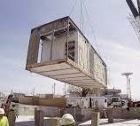
2 Pilot 2 試驗 2– Onsite Assembly PM/QA
<BSCO #GUID> in blockchain BIM
Geometry: As-is 3D model
Semantics: 3D motion curves, time series, status, assembly error, … Relation: Receiver, site storage, storage inspectors, assembly schedule, crane, erection inspector, photos, payment …
Pilot 2: SaaS BI for onsite users
Focusing onsite storage, locationing, monitoring, tracking, safety,…
The same project
On site /with main contractor at Wong Chuk Hang, Hong Kong
By blockchaining SCOs (different data) using
Hardware oracles (i-Core Type 2) and
Software oracles (as-built 3D scan, inspections, docs, ERP)
Identical 4 phases of implementation
Phase 1 (6 months): Business processes, and requirements analysis
Phase 2 (6 months): Installing i-Core, collect data, testing SaaS BI (Alpha)
Phase 3 (6 months): Extended scale (offline) pilot (Ver. Beta), API tests
Phase 4 (6 months): Online production deployment of SaaS BI (Ver. 1.0)

Slide 25

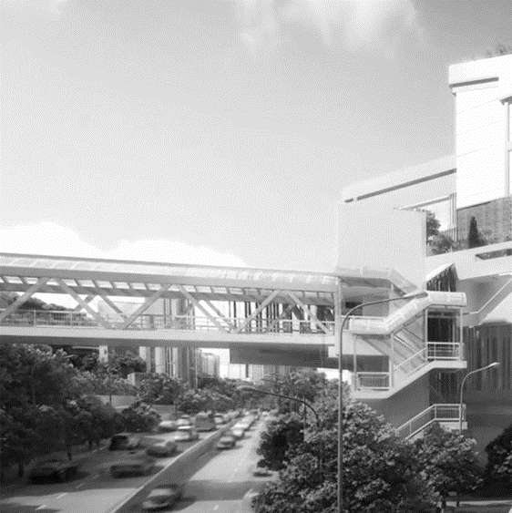
2 Pilot 3 試驗 3 – Infrastructure PM/QA
Pilot 3: SaaS BI for infrastructure projects users
Focusing on the difference in requirements, functions, and KPIs
<BSCO #GUID> in blockchain BIM Geometry: As-designed 3D, as-is 3D Semantics: 2D geolocation list,
3D motion curves, time series, status, assembly error, …
Relation: Receiver, site storage, storage inspectors, assembly schedule, crane, erection inspector, photos, payment …
Mainly on the cost-significant activities and site areas.
For more marketing opportunities
2nd construction project: Connection at Sassoon Road Campus
Technologies: DfMA + MiC
At Mainland factory and on site at Sassoon Road Campus
Identical 4 phases of implementation
Phase 1 (6 months): Business processes, and requirements analysis
Phase 2 (6 months): Installing i-Core, collect data, testing SaaS BI (Alpha)
Phase 3 (6 months): Extended scale (offline) pilot (Ver. Beta), API tests
Phase 4 (6 months): Online production deployment of SaaS BI (Ver. 1.0)

